Slide 1
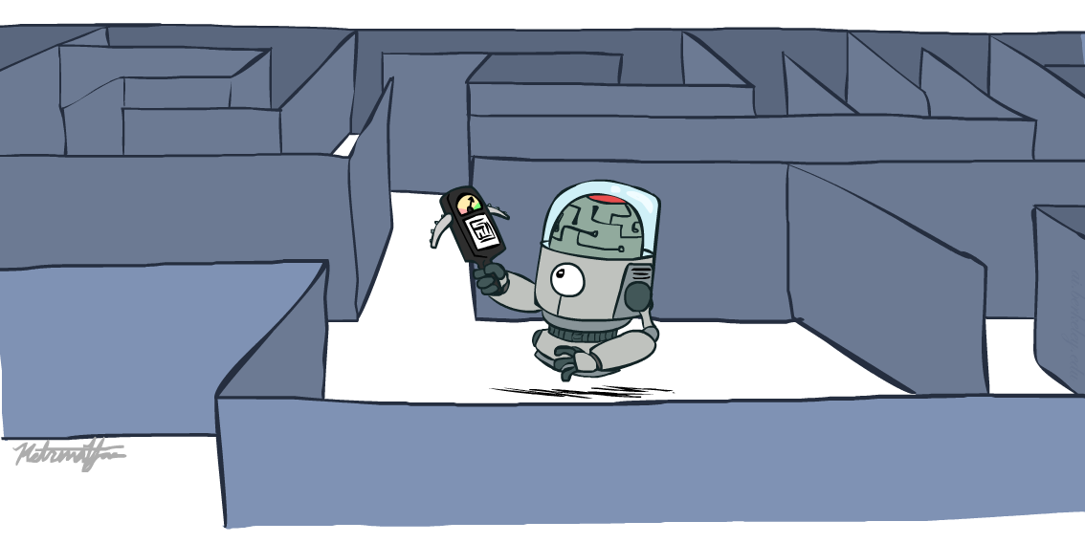
Artificial Intelligence
Ch3: Problem Solving by Search – Part3
Instructor: Iyad H Alshami
[These slides adopted from Dan Klein and Pieter Abbeel at UC Berkeley ai.berkeley.edu]
Notes:
[These slides adopted from Dan Klein and Pieter Abbeel at UC Berkeley ai.berkeley.edu]
Build agents that plans ahead. Act rationally.

Slide 2
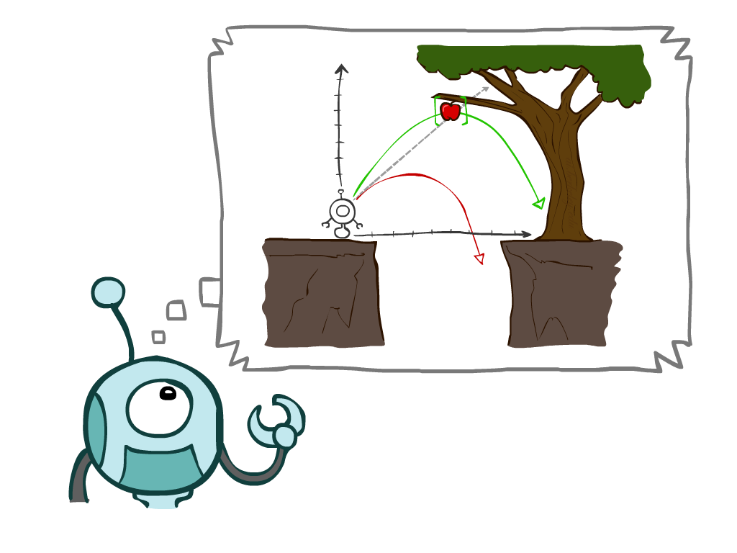
Chapter Outline
3.1 Problem-Solving Agents
3.2 Example Problems
3.3 Search Algorithms
3.4 Uninformed Search Strategies
Depth-First Search
Breadth-First Search
Uniform-Cost Search
3.5 Informed (Heuristic) Search Strategies
3.6 Heuristic Functions
Notes:
Many you have seen before.
General theme in the class:
A goal we have in mind.
A mathematical abstraction to formalize this
Algorithms that operate on these abstractions
Unified formalism leading to A* search (search guided by heuristic)

Slide 3
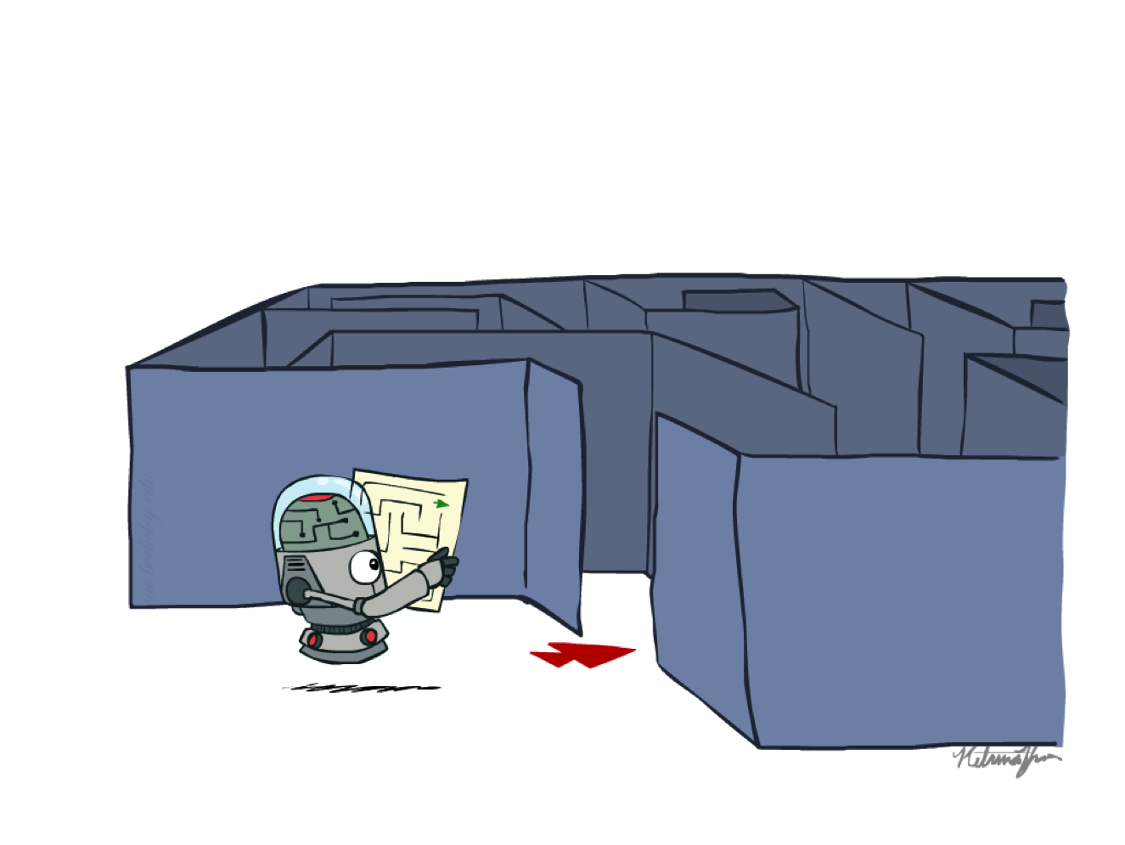
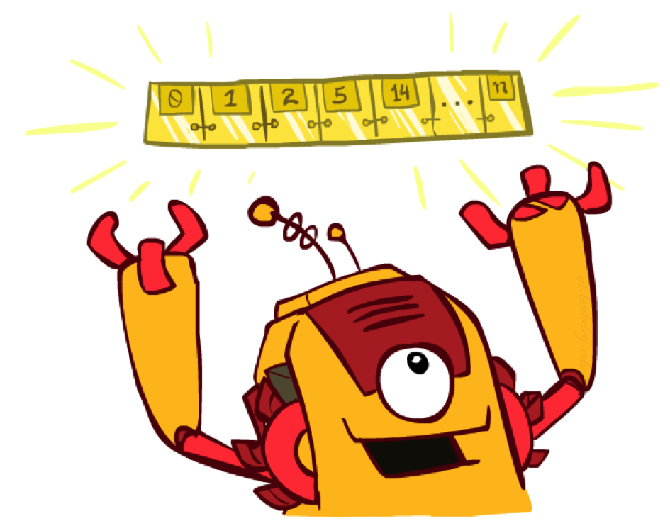
Recap: Search
Search problem:
States (configurations of the world)
Actions and costs
Successor function (world dynamics)
Start state and goal test
Search tree:
Nodes: represent plans for reaching states
Plans have costs (sum of action costs)
Search algorithm:
Systematically builds a search tree
Chooses an ordering of the fringe (unexplored nodes)
Optimal: finds least-cost plans
All these search algorithms are the same except for fringe strategies
Notes:
successor function returns the set of all successors, instead of separate ACTIONS and RESULT functions. The successor function makes it difficult to describe an agent that knows what actions it can try but not what they achieve.
successor to refer to any state reachable from a given state by a single action.
Fringe: Set of search nodes that have not been expanded yet.

Slide 4
3.5 Informed (Heuristic) Search Strategies

Slide 5
Informed Search
Informed search strategy—one that uses problem-specific knowledge beyond the definition of the problem itself—can find solutions more efficiently than can an uninformed strategy.
The general approach we consider is called best-first search.
Best-first search is an instance of the general TREE-SEARCH or GRAPH-SEARCH algorithm in which a node is selected for expansion based on an evaluation function, f(n).
The evaluation function is construed as a cost estimate, so the node with the lowest evaluation is expanded first.

Slide 6
Informed Search
best-first search is implemented as uniform-cost search, except for the use of f instead of g to order the priority queue.
The choice of f determines the search strategy.
Most best-first algorithms include as a component of f a heuristic function, denoted h(n):
h(n) = estimated cost of the cheapest path from the state at node n to a goal state.
Notes:
(For example, as Exercise 3.21 shows, best-first tree search includes depth-first search as a special case.)

Slide 7
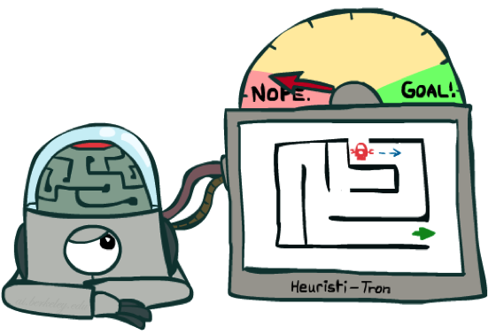
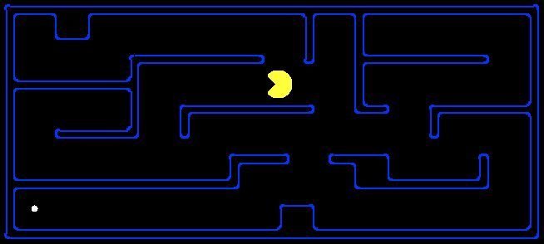
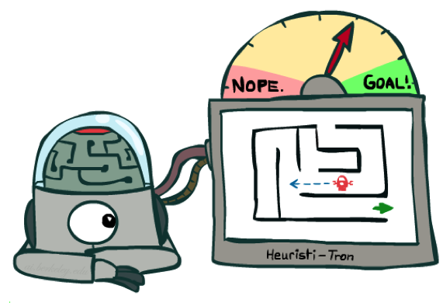
Search Heuristics
A heuristic is:
A function that estimates how close a state is to a goal
Designed for a particular search problem
Examples:
Manhattan distance, Euclidean distance for pathing
10
5
11.2

Slide 8
Example: Heuristic Function
h(n)
Notice that the values of h(n) cannot be computed from the problem description itself.

Slide 9
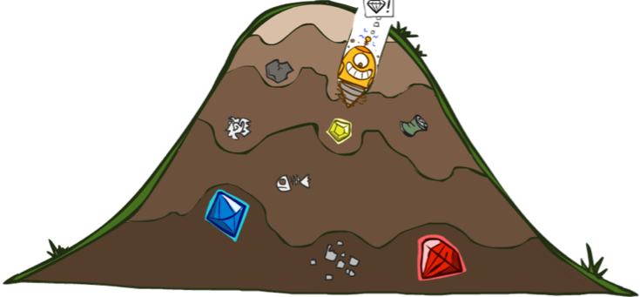
Greedy best-first search
Greedy best-first search tries to expand the node that is closest to the goal, on the grounds that this is likely to lead to a solution quickly.
It evaluates nodes by using just the heuristic function f (n) = h(n).
e.g.: straight- line distance heuristic function
Notes:
Our first edition called this greedy search; other authors have called it best-first search.

Slide 10


Greedy best-first search
Expand the node that seems closest…
What can go wrong?

Slide 11
Greedy best-first search
Strategy: expand a node that you think is closest to a goal state
Heuristic: estimate of distance to nearest goal for each state
A common case:
Best-first takes you straight to the (wrong) goal
Worst-case: like a badly-guided DFS
b
…
b
…
[Demo: contours greedy pacman small maze (L3D4)]
Notes:
For any search problem, you know the goal. Now, you have an idea of how far away you are from the goal.

Slide 12

Demo Contours Greedy (Pacman Small Maze)

Slide 13
A* Search: Minimizing the total estimated solution cost
The most widely known form of best-first search is called A∗ search
It evaluates nodes by combining g(n), the cost to reach the node, and h(n), the cost to get from the node to the goal:
f(n) = g(n) + h(n)
Since g(n) gives the path cost from the start node to node n, and h(n) is the estimated cost of the cheapest path from n to the goal:
f(n) = estimated cost of the cheapest solution through n .
A* is identical to Uniform-cost-search except that A∗ uses g + h instead of g.

Slide 14

A* Search
UCS
Greedy
A*

Slide 15
Combining UCS and Greedy
Uniform-cost orders by path cost, or backward cost g(n)
Greedy orders by goal proximity, or forward cost h(n)
A* Search orders by the sum: f(n) = g(n) + h(n)
8
g = 0 h=6
S
e
h=1
g = 1 h=5
a
1
1
3
2
g = 2 h=6
g = 9 h=1
S
a
d
G
b
d
g = 4 h=2
e
h=6
1
h=5
h=2
h=0
1
g = 3 h=7
g = 6 h=0
g = 10 h=2
c
b
c
G
d
h=7
h=6
g = 12 h=0
G
Example: Teg Grenager

Slide 16
When should A* terminate?
Should we stop when we enqueue a goal?
No: only stop when we dequeue a goal
h = 2
A
2
2
S
h = 3
h = 0
G
2
B
3
h = 1

Slide 17
Is A* Optimal?
h = 6
1
A
3
S
h = 7
G
h = 0
5
What went wrong?
Actual bad goal cost < estimated good goal cost
We need estimates to be less than actual costs!

Slide 18
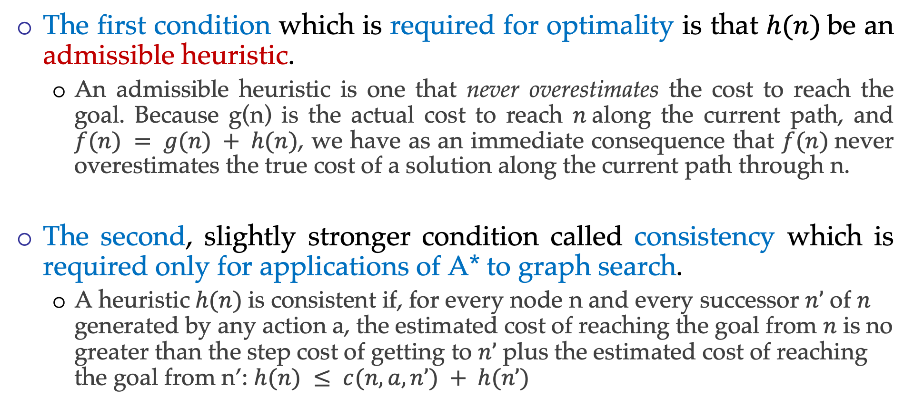
A* Conditions for optimality: Admissibility and consistency
The first condition which is required for optimality is that $h(n)$be an admissible heuristic.
An admissible heuristic is one that never overestimates the cost to reach the goal. Because g(n) is the actual cost to reach $n$along the current path, and $f(n) = g(n) + h(n)$, we have as an immediate consequence that $f(n)$never overestimates the true cost of a solution along the current path through n.
The second, slightly stronger condition called consistency which is required only for applications of A* to graph search.
A heuristic$h(n)$is consistent if, for every node n and every successor $n’$ of $n$ generated by any action a, the estimated cost of reaching the goal from $n$ is no greater than the step cost of getting to $n’$ plus the estimated cost of reaching the goal from n’: $h(n) ≤ c(n, a, n’) + h(n’)$
Notes:
consistency (or sometimes monotonicity)

Slide 19
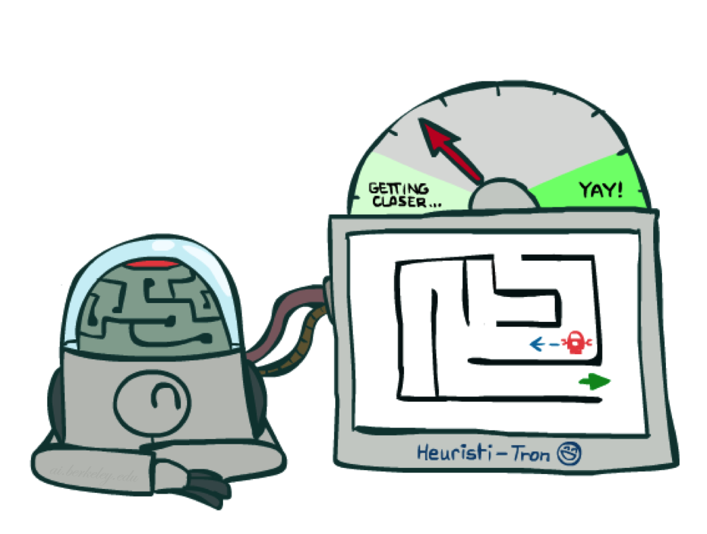
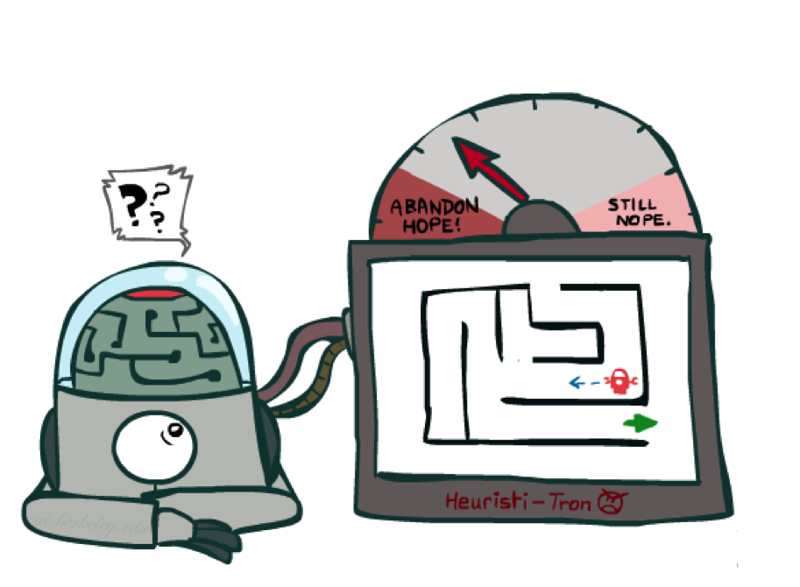
Admissible Heuristics
Idea: Admissibility
Inadmissible (pessimistic) heuristics break optimality by trapping good plans on the fringe
Admissible (optimistic) heuristics slow down bad plans but never outweigh true costs
Notes:
Admissibility = the quality of being acceptable or valid
Heuristic = enabling some one to learn by himself/herself. Or proceeding a solution by trail and error or by rule that are loosely defined
Optimistic = hopeful and confident about the future

Slide 20
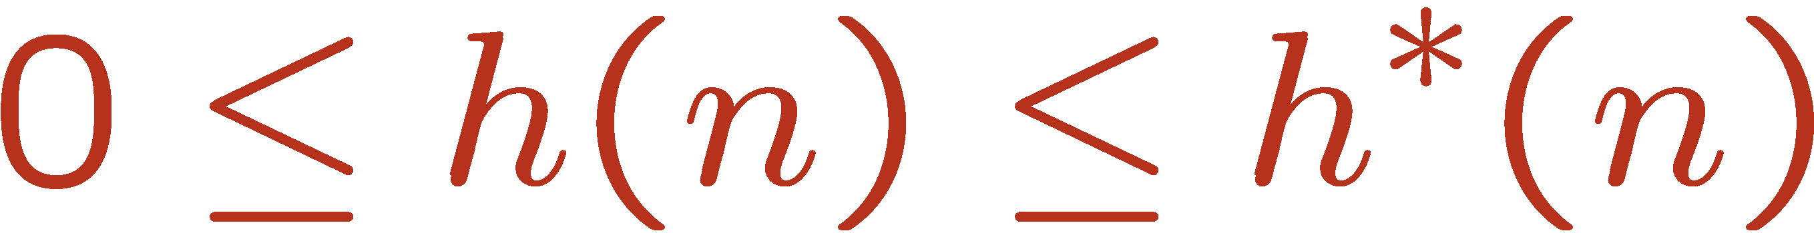
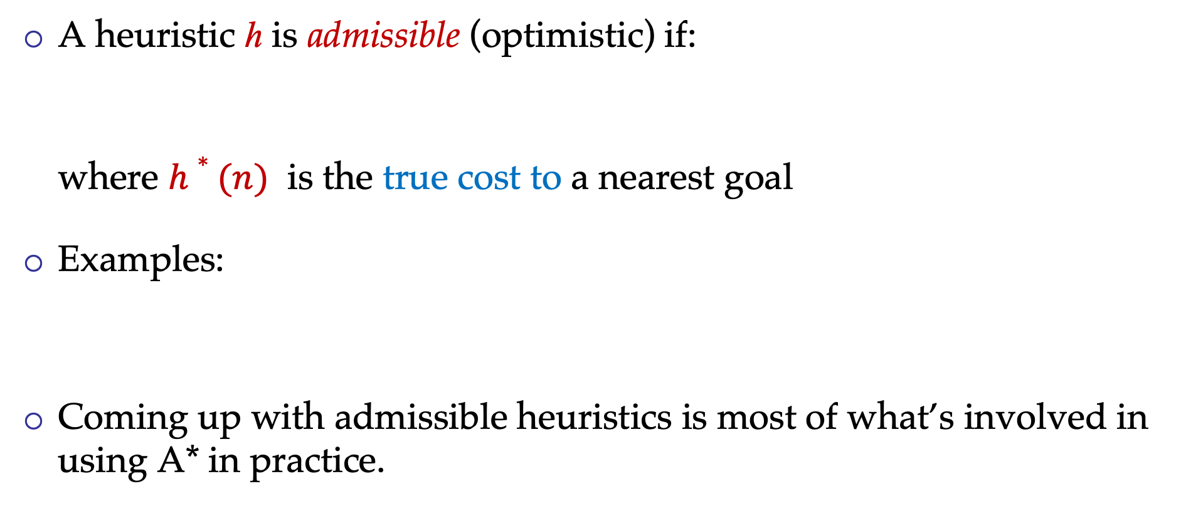
Admissible Heuristics
A heuristic h is admissible (optimistic) if:
where $h∗(n)$ is the true cost to a nearest goal
Examples:
Coming up with admissible heuristics is most of what’s involved in using A* in practice.
4
15

Slide 21


Optimality of A* Tree Search
Assume:
A is an optimal goal node
B is a suboptimal goal node
h is admissible
Claim:
A will exit the fringe before B
…

Slide 22

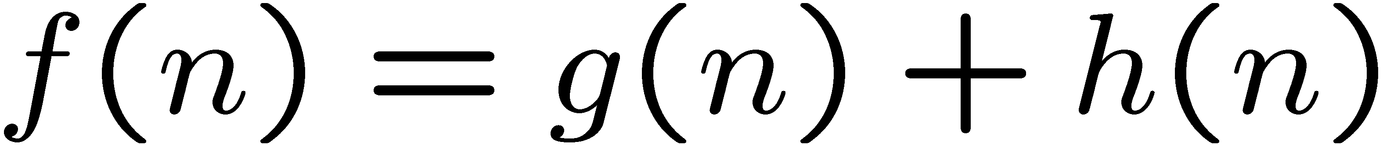
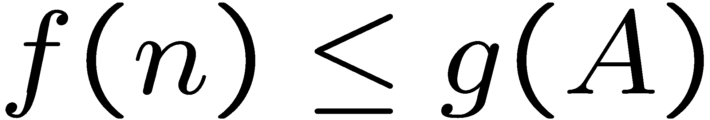
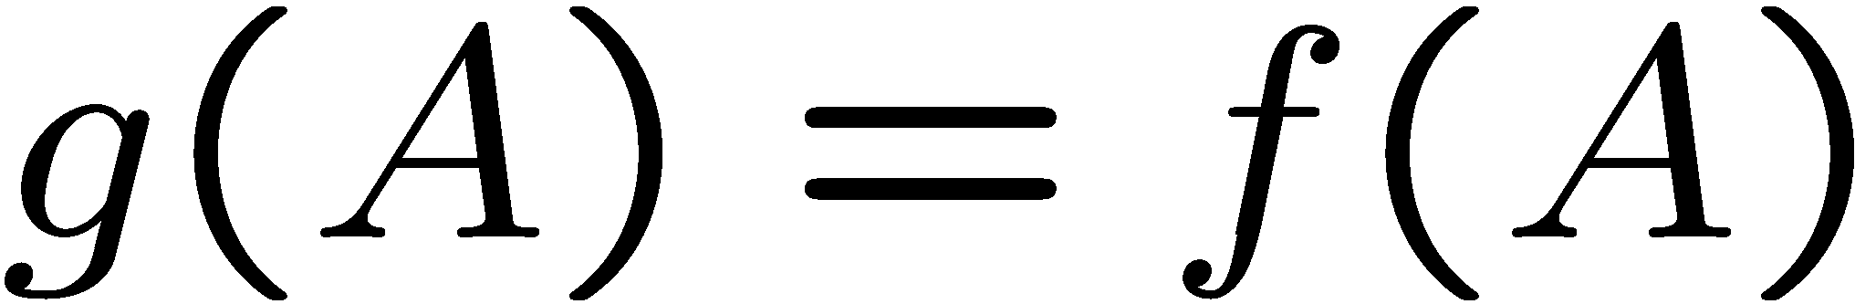
Optimality of A* Tree Search: Blocking
Proof:
Imagine B is on the fringe
Some ancestor n of A is on the fringe, too (maybe A!)
Claim: n will be expanded before B
f(n) is less or equal to f(A)
…
Definition of f-cost
Admissibility of h
h = 0 at a goal

Slide 23
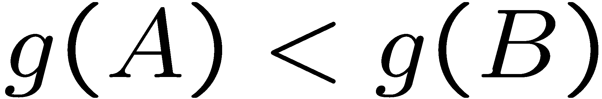
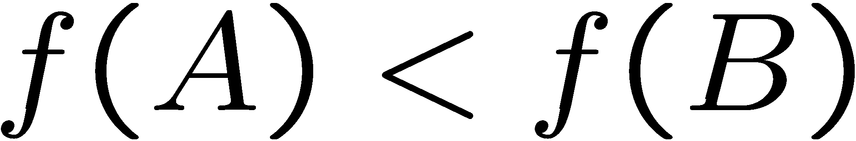
Optimality of A* Tree Search: Blocking
Proof:
Imagine B is on the fringe
Some ancestor n of A is on the fringe, too (maybe A!)
Claim: n will be expanded before B
f(n) is less or equal to f(A)
f(A) is less than f(B)
…
B is suboptimal
h = 0 at a goal

Slide 24

Optimality of A* Tree Search: Blocking
Proof:
Imagine B is on the fringe
Some ancestor n of A is on the fringe, too (maybe A!)
Claim: n will be expanded before B
f(n) is less or equal to f(A)
f(A) is less than f(B)
n expands before B
All ancestors of A expand before B
A expands before B
A* search is optimal
…

Slide 25

Optimality of A* Tree Search

Slide 26
Properties of A* UCS vs A* Contours
b
Uniform-cost expands equally in all “directions”
A* expands mainly toward the goal, but does hedge its bets to ensure optimality
…
Start
Goal
b
…
Start
Goal

Slide 27
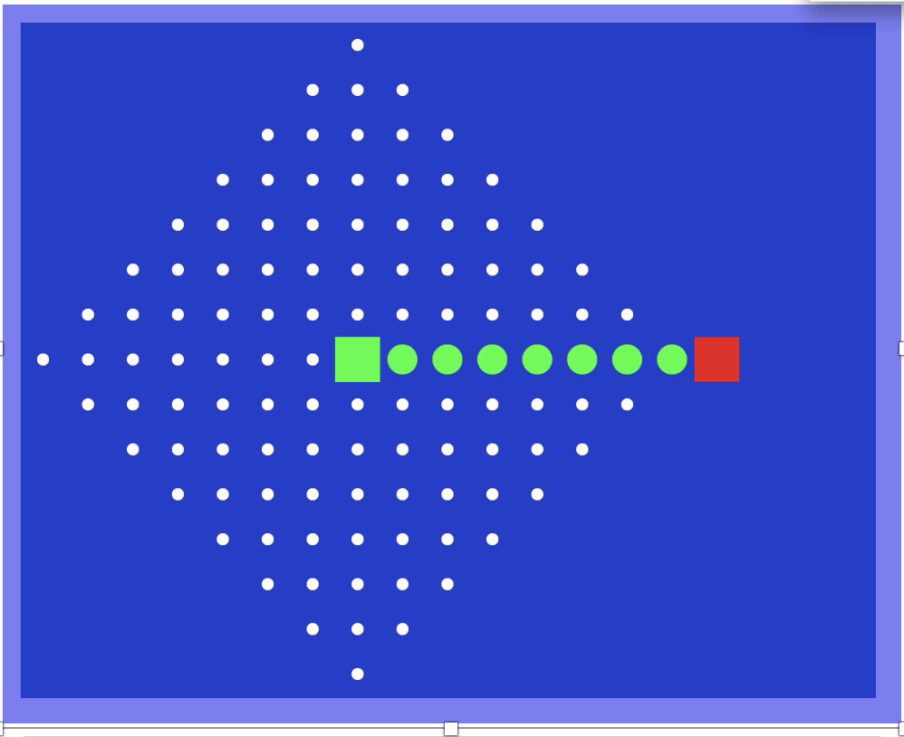
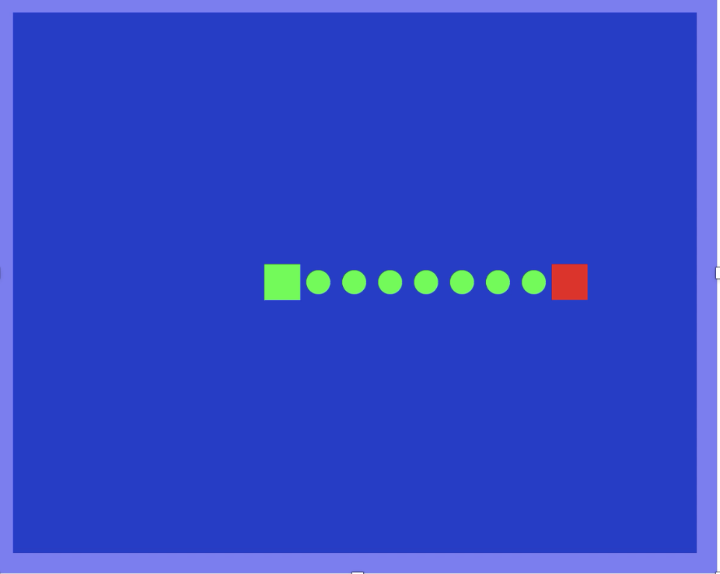
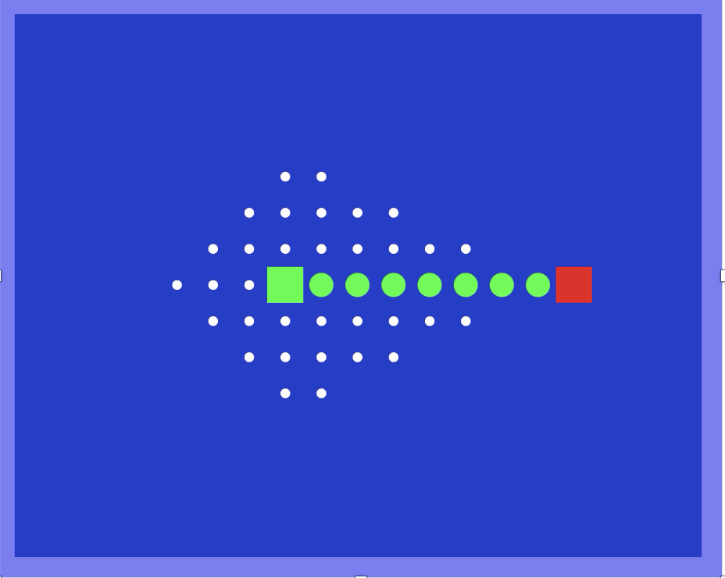
Video of Demo Contours (Empty)
UCS
Greedy
A*

Slide 28
A* Applications
Video games
Pathing / routing problems
Resource planning problems
Robot motion planning
Language analysis
Machine translation
Speech recognition
…

Slide 29
Creating Admissible Heuristics
Most of the work in solving hard search problems optimally is in coming up with admissible heuristics
Often, admissible heuristics are solutions to relaxed problems, where new actions are available
Inadmissible heuristics are often useful too
366
15
Notes:
problem with fewer restrictions on the actions is called a relaxed problem.

Slide 30
3.6 Heuristic Functions
In this section, we look at heuristics for the 8-puzzle, in order to shed light on the nature of heuristics in general.

Slide 31
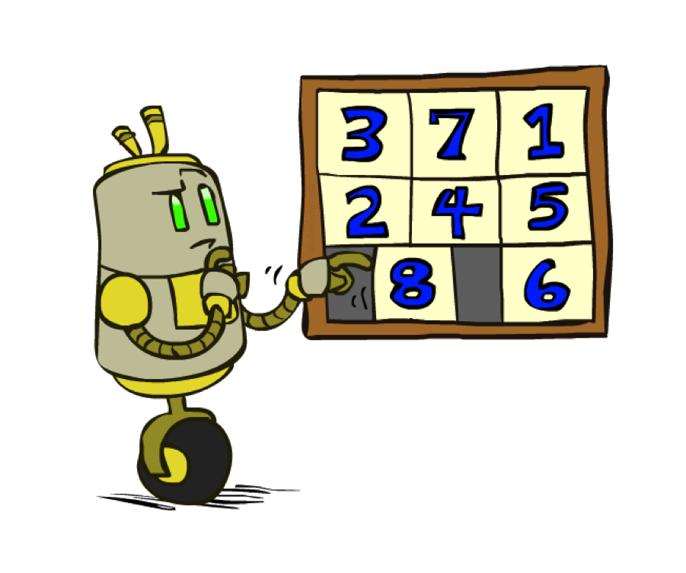
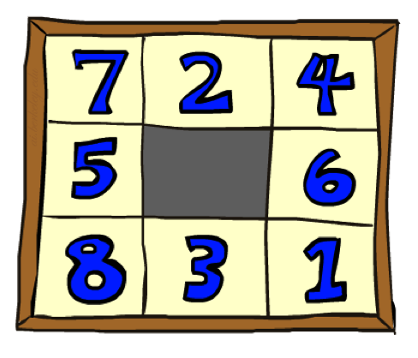
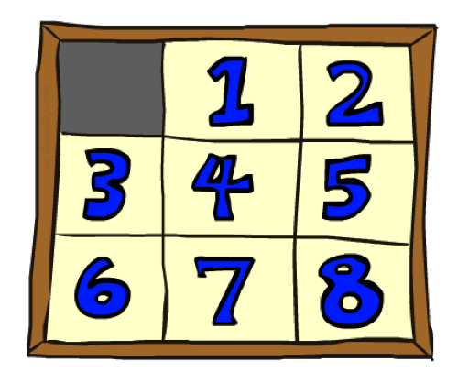
Example: 8 Puzzle
Start State
Actions
Goal State
What are the states?
How many states?
What are the actions?
How many successors from the start state?
What should the costs be?

Slide 32
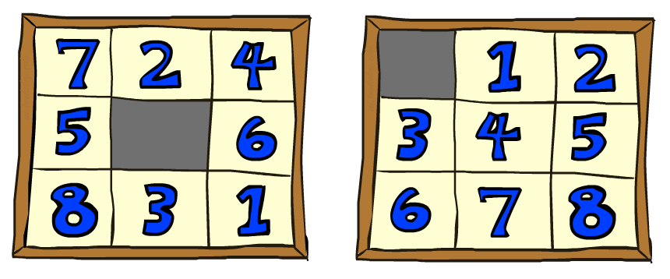
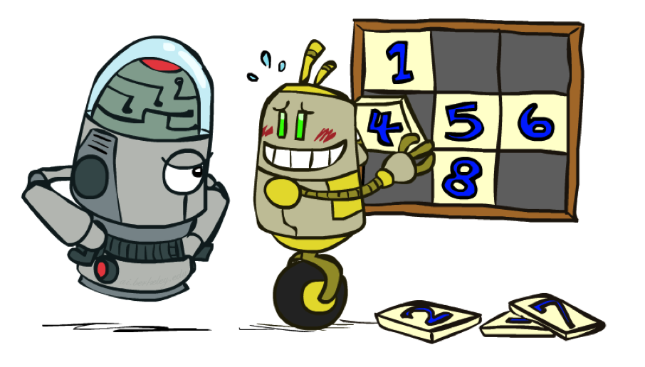
8 Puzzle I
Heuristic: Number of tiles misplaced
Why is it admissible?
h(start) =
This is a relaxed-problem heuristic
8
Start State
Goal State
 | Average nodes expanded when the optimal path has…
 | …4 steps | …8 steps | …12 steps
UCS | 112 | 6,300 | 3.6 x 10⁶
TILES | 13 | 39 | 227
Statistics from Andrew Moore

Slide 33
8 Puzzle II
What if we had an easier 8-puzzle where any tile could slide any direction at any time, ignoring other tiles?
Total Manhattan distance
Why is it admissible?
h(start) =
Start State
Goal State
 | Average nodes expanded when the optimal path has…
 | …4 steps | …8 steps | …12 steps
TILES | 13 | 39 | 227
MANHATTAN | 12 | 25 | 73
3 + 1 + 2 + … = 18

Slide 34
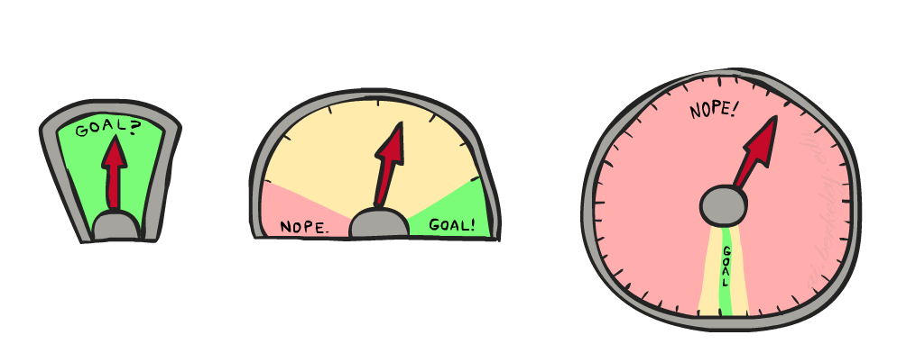
8 Puzzle III
How about using the actual cost as a heuristic?
Would it be admissible?
Would we save on nodes expanded?
What’s wrong with it?
With A*: a trade-off between quality of estimate and work per node
As heuristics get closer to the true cost, you will expand fewer nodes but usually do more work per node to compute the heuristic itself

Slide 35
Let’s Stop Here

Slide 36
Semi-Lattice of Heuristics

Slide 37







Trivial Heuristics, Dominance
Dominance: h_{a} ≥ h_{c} if
Heuristics form a semi-lattice:
Max of admissible heuristics is admissible
Trivial heuristics
Bottom of lattice is the zero heuristic (what does this give us?)
Top of lattice is the exact heuristic
Notes:
Semi-lattice: x <= y <-> x = x ^ y

Slide 38
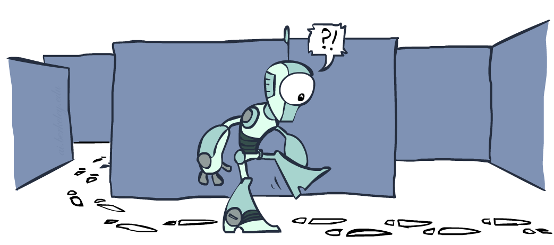
Graph Search

Slide 39
Tree Search: Extra Work!
Failure to detect repeated states can cause exponentially more work.
State Graph
Search Tree

Slide 40
Graph Search
In BFS, for example, we shouldn’t bother expanding the circled nodes (why?)
S
d
e
p
b
c
e
h
r
q
a
a
h
r
p
q
f
p
q
f
q
c
G
q
c
G
a
a

Slide 41
Graph Search
Idea: never expand a state twice
How to implement:
Tree search + set of expanded states (“closed set”)
Expand the search tree node-by-node, but…
Before expanding a node, check to make sure its state has never been expanded before
If not new, skip it, if new add to closed set
Important: store the closed set as a set, not a list
Can graph search wreck completeness? Why/why not?
How about optimality?

Slide 42
A* Graph Search Gone Wrong?
State space graph
Search tree
A
S (0+2)
1
S
1
C
h=4
h=1
A (1+4)
B (1+1)
h=2
1
2
B
3
C (2+1)
C (3+1)
h=1
G
G (5+0)
G (6+0)
h=0

Slide 43
Consistency of Heuristics
Main idea: estimated heuristic costs ≤ actual costs
Admissibility: heuristic cost ≤ actual cost to goal
h(A) ≤ actual cost from A to G
Consistency: heuristic “arc” cost ≤ actual cost for each arc
h(A) – h(C) ≤ cost(A to C)
Consequences of consistency:
The f value along a path never decreases
h(A) ≤ cost(A to C) + h(C)
A* graph search is optimal
A
1
C
h=4
h=1
h=2
3
G

Slide 44
Optimality of A* Graph Search

Slide 45
Optimality of A* Graph Search
Sketch: consider what A* does with a consistent heuristic:
Fact 1: In tree search, A* expands nodes in increasing total f value (f-contours)
Fact 2: For every state s, nodes that reach s optimally are expanded before nodes that reach s suboptimally
Result: A* graph search is optimal
…
f ≤ 1
f ≤ 2
f ≤ 3

Slide 46
Optimality
Tree search:
A* is optimal if heuristic is admissible
UCS is a special case (h = 0)
Graph search:
A* optimal if heuristic is consistent
UCS optimal (h = 0 is consistent)
Consistency implies admissibility
In general, most natural admissible heuristics tend to be consistent, especially if from relaxed problems

Slide 47

A*: Summary

Slide 48
A*: Summary
A* uses both backward costs and (estimates of) forward costs
A* is optimal with admissible / consistent heuristics
Heuristic design is key: often use relaxed problems

Slide 49
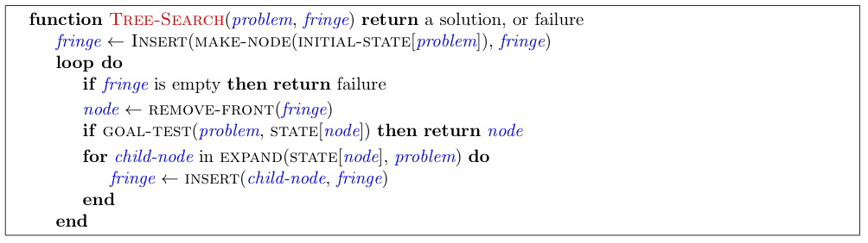
Tree Search Pseudo-Code

Slide 50
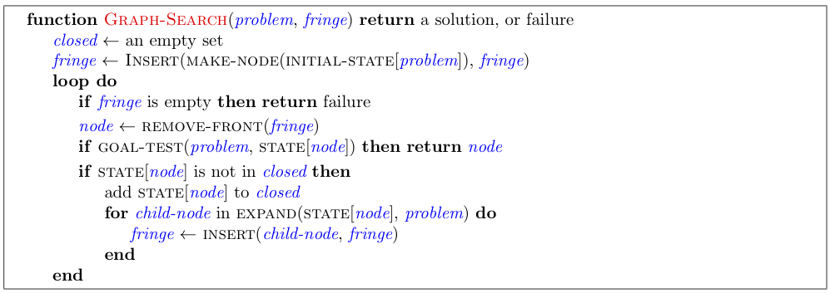
Graph Search Pseudo-Code

Slide 51
Optimality of A* Graph Search
Consider what A* does:
Expands nodes in increasing total f value (f-contours) Reminder: f(n) = g(n) + h(n) = cost to n + heuristic
Proof idea: the optimal goal(s) have the lowest f value, so it must get expanded first
…
f ≤ 1
There’s a problem with this argument. What are we assuming is true?
f ≤ 2
f ≤ 3

Slide 52

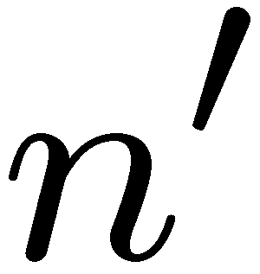
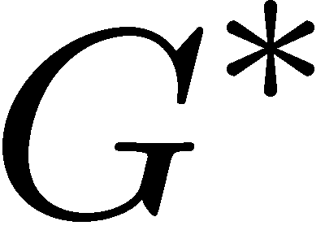

Optimality of A* Graph Search
Proof:
New possible problem: some n on path to G* isn’t in queue when we need it, because some worse n’ for the same state dequeued and expanded first (disaster!)
Take the highest such n in tree
Let p be the ancestor of n that was on the queue when n’ was popped
f(p) < f(n) because of consistency
f(n) < f(n’) because n’ is suboptimal
p would have been expanded before n’
Contradiction!

